Slide 1
Graphical User Interfaces
Barb Ericson
ericson@cc.gatech.edu
April 2006

Slide 2
Learning Goals
Understand at a conceptual and practical level
  How to create a main frame window.
  How to create graphical components.
  How to use layout managers.
  How to handle user interface events.

Slide 3
Abstract Window Toolkit - AWT
Original Graphical User Interface (GUI) Classes
  Container Objects
    Frame - Main window with title and border.
    Panel - groups components
    Canvas - create custom components
  Input and Output Classes
    Label - not editable text
    Button - pushing fires an event
      Checkboxes and Radio Buttons
    TextField - input and output of text
    TextArea - input and output of multiple lines of text
    List - Select one or more items from a displayed list
    Choice - Select one from a drop down list

Slide 4
Component – java.awt
A visual object in a GUI
  Displayed on the computer screen
  May allow user interaction
Example components
  A button
  A label
  A panel
What do all components have?
  A background color
  Alignments in x and y
  A size (bounds)

Slide 5

Container – java.awt
Containers hold components
  You can add components
  You can remove components
  You can set the preferred size of the container
  You can get the component at a location
  You can get the number of components in the container
Notes:
A container is also a component.

Slide 6
Swing - javax.swing
Replacements for most AWT components
  JButton - Button (images and text)
  JFrame - Frame (main window)
  JPanel – Panel (container)
New GUI components
  Trees - JTree
  Split pane - JSplitPane
  Table - JTable
Supports multiple looks and feels
  Java - also called metal, Windows, Mac, Motif
Notes:
Chapter 10 - <number>
A visual index to the swing components is at http://java.sun.com/docs/books/tutorial/uiswing/components/components.html
The windows look and feel only works on Win32 systems.
The mac look and feel only works on mac os systems.
SDK 1.4 comes with a SwingSet example in demo\jfc\SwingSet. Run the demo with
change directory to the SwingSet directory in a msdos window
java -jar SwingSet.jar

Slide 7
Swing versus AWT
With Java 1.1+ use Swing instead of AWT components.
  Pure java - no native code
    consistent across platforms
  More and better GUI components
    Images can be used in buttons and labels
    Components can have borders
    Tool tips (pop-up information about components)
Avoid mixing Swing and AWT components!
Notes:
Chapter 10 - <number>
Most Swing components are lightweight meaning that they borrow the screen resource of an ancestor to do their drawing.
can have transparent pixels
can appear to be non rectangular because of the transparent pixels
All AWT components are heavyweight. This means that they are associated with native screen resources.
always opaque
always rectangular
always drawn on top of a lightweight component
If you must mix Swing and AWT components read the article at http://java.sun.com/products/jfc/tsc/articles/mixing/index.html.
Swing can be used with Java 1.1 but it is separate from the JDK. In Java 1.2 Swing is included in the SDK.
Use AWT components when you must use only Java 1.0 or 1.1 without Swing such as if you are creating applets that should run on the largest number of browsers.

Slide 8


Swing Top-Level Containers
JFrame - main window with title, maybe a menu bar, and the ability to minimize, maximize, and close the window
JApplet - main window for an applet. Inherits from java.applet.Applet
JDialog – pop-up window for simple communication with the user
  Like the JFileChooser
Notes:
Chapter 10 - <number>

Slide 9
Working with a JFrame
Pass the title when you create it
  JFrame frame = new JFrame("FrameDemo");
Add components to the content pane
JLabel label = new JLabel("Hello World");
frame.getContentPane().add(label, BorderLayout.CENTER);
Set the size of the JFrame
  frame.pack(); // as big as needs to be to display contents
Display the JFrame
  frame.setVisible(true); // display the frame
Notes:
Chapter 10 - <number>

Slide 10
JFrame Options
When creating a GUI application
  Have your main class inherit from JFrame
    So it is a JFrame
    See PhotoAlbum.java in the PhotoAlbum directory
  Or have your main class inherit from JPanel
    And create a JFrame in the main method
    Create the main class object
    Add the main class object to the content pane of the JFrame
    See PicturePanel.java in the PhotoAlbum directory
If your class inherits from JPanel
  It can be reused in another application
    Even an applet

Slide 11
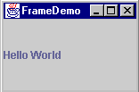
FrameDemo Exercise
Compile and execute FrameDemo/FrameDemo.java
Maximize the window by clicking on the rectangle in the top right corner of the window
Close the window by clicking on the x in the top right corner of the window
Notes:
Chapter 10 - <number>

Slide 12
Layout Managers
How are the components assigned a position and size?
  setLayout(null) - the programmer must give all components a size and position
    setBounds(topLeftX,topLeftY,width,height);
  Use a Layout Manager
    Arranges the components in a container and sets their size as well
    Handles when the main window is resized
      Some components may get more space
    The programmer just adds the components to the container
Notes:
Chapter 10 - <number>
The top left corner of a container is 0,0 with X increasing to the left and y increasing to the bottom.

Slide 13
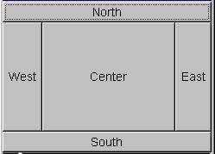

Layouts - Flow, Border, Grid
Flow Layout - left to right, no extra space
Border Layout - Center item gets extra space
Grid Layout - same size components
Notes:
Chapter 10 - <number>

Slide 14
LayoutDemo Exercise
Run the main method in the LayoutDemo
  What layout manager does it use?
  Are the buttons all the same size?
Change the layout manager to be a GridLayout
  this.setLayout(new GridLayout(3,2));
  Run the main method
  Are the buttons all the same size?
Change the layout manager to be BorderLayout
  Change the add to add to a location
  this.add(button1,BorderLayout.WEST);
Notes:
When you use BorderLayout you need to tell it where to add the component. You can use the constants BorderLayout.NORTH, BorderLayout.SOUTH, BorderLayout.WEST, BorderLayout.EAST, and BorderLayout.CENTER.

Slide 15

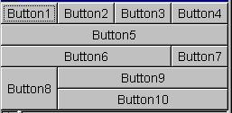


Layouts - None, GridBag, Card
None (null) - programmer specified
GridBag - flexible grid
Card - one card shown at a time
Notes:
Chapter 10 - <number>

Slide 16
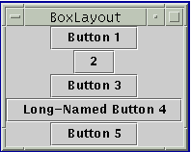
BoxLayout –javax.swing
Two types
  Horizontal - BoxLayout.X_AXIS
  Vertical - BoxLayout.Y_AXIS
Can use rigidAreas to leave a set amount of space between components
  Box.createRigidArea(new Dimension(0,5)));
Can use horizontal and/or vertical glue to take up extra space
  Box.createHorizontalGlue());
Notes:
Chapter 10 - <number>
BoxLayout is in javax.swing.
See http://java.sun.com/docs/books/tutorial/uiswing/layout/box.html for the tutorial on BoxLayout.

Slide 17
BoxDemo Exercise
Run BoxDemo
  Resize the window larger
    What happens to the buttons?
Change BoxDemo to center the buttons
  button1.setAlignmentX(Component.CENTER_ALIGNMENT);
  button2.setAlignmentX(Component.CENTER_ALIGNMENT);
  …
Change BoxDemo to use a horizontal box
  Change the code to
    Box box = new Box(BoxLayout.Y_AXIS);
  Run BoxDemo
  Resize the window larger
    What happens to the buttons?

Slide 18
Which Layout to Use?
An applet or application can have multiple panels (JPanel) and have a different layout in each panel.
  Panels can be inside of other panels.
If you want components to not use extra space and stay centered then use FlowLayout()
Or use BorderLayout and put one component that uses all extra space in the center.
Use a Box and line up components vertically or horizontally
For the most control use null layout.
Notes:
Chapter 10 - <number>

Slide 19
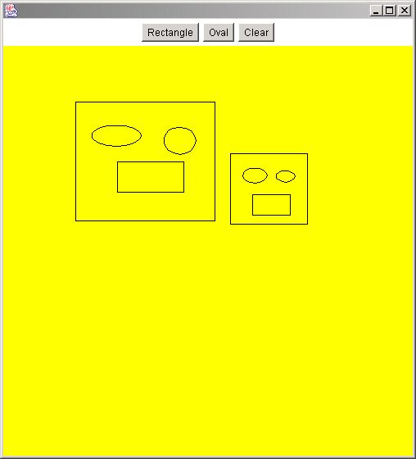
Nested Panel Example
Often an application uses a BorderLayout
  Main panel in Center
  Other panels in North, South, West, and East as needed
    Using FlowLayout or Box
In the application at right
  The main panel is in the center
  The button panel is in the north
    Using FlowLayout

Slide 20
Events
An event is an object that represents an action:
  user clicks the mouse
  user presses a key on the keyboard
  user closes a window
Event handling changed between 1.0 and 1.1
  In 1.0 objects handle events and return true to show that the event was handled or false to let other objects handle the event.
  In 1.1+ objects add or implement listeners for events. Listeners are interfaces.
Notes:
Chapter 10 - <number>

Slide 21
1.1 Event Handling - java.awt.event.*
A listener interface is defined for each event.
  ActionListener interface for ActionEvent specifies the method:
    public actionPerformed(ActionEvent e);
Objects register themselves as listening for one or more events.
    stopButton.addActionListener(this);
When the event occurs all listeners are notified.
    public void actionPerformed(ActionEvent e) {
      System.exit(0);
    }
Notes:
Chapter 10 - <number>

Slide 22

Events and Listeners
Say you want to know when your favorite band will be giving a tour in your city
You might sign-up to be notified and give your e-mail address
  Your name and e-mail is added to a list
When the event is scheduled in your city
  You will be notified via e-mail that the tour is coming

Slide 23
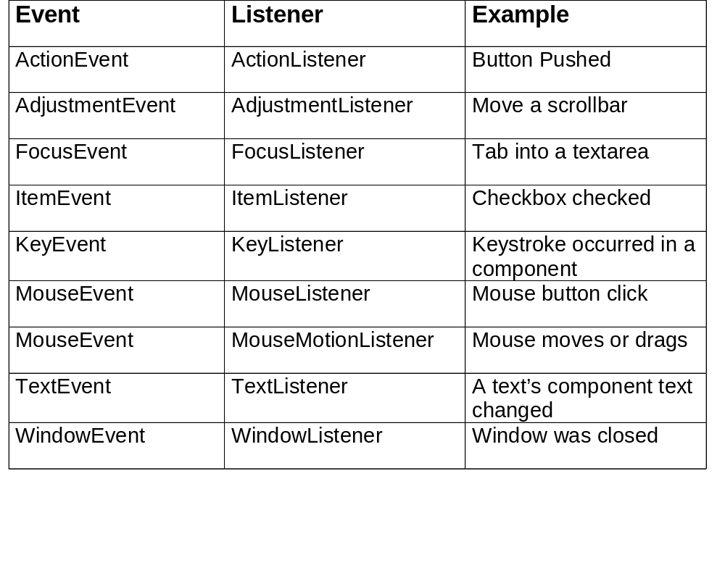
Events and Listeners
Notes:
Chapter 10 - <number>

Slide 24
1.1 AWT Event Example
public class ButtonPanel extends JPanel implements ActionListener
{
  private JButton quitButton = new JButton(“Quit”);
  public ButtonPanel ()
  {
    add(quitButton);
    quitButton.addActionListener(this);
  }
  public void actionPerformed(ActionEvent evt)
  {
  System.exit(0); // exit the application
  }
}
Notes:
Chapter 10 - <number>
This example shows one approach to event handling. The class that wants to handle the event implements the event interface. This means that it must implement the methods defined in the event interface.
Use addActionListener to register this object as the listener for the ActionEvent on the button.
The ActionListener interface only has one event in it
public void actionPerformed(ActionEvent evt)

Slide 25
Button Panel Exercise
Add another button “Change” to the button panel
  That changes the panel’s background color when pushed
Add a check for which button resulted in the action event in the actionPerformed method
  if (evt.getSource() == changeButton)
If the change button was pushed call a method to change the color
  Using a color array and a color index
  Increment the color index and reset if necessary to 0
  Set the panel background color
Notes:
Declare and create the changeButton field
private JButton changeButton = new JButton("Chage");
Add it to the panel and add the current panel as the action listener in the constructor
add(changeButton);
changeButton.addActionListener(this);

Slide 26
Adapters
An adapter is an abstract class that provides empty implementations for a listener interface.
  You can inherit from an adapter and only override the methods you want to handle.
  class MyMouseAdapter extends MouseAdapter
  {
  /** Method to handle the click of a mouse */
  public void mouseClicked(MouseEvent e)
  { … }
  }
Notes:
Chapter 10 - <number>
The MouseListener interface has 5 methods that must be implemented:
public void mouseClicked(MouseEvent e)
public void mouseEntered(MouseEvent e)
public void mouseExited(MouseEvent e)
public void mousePressed(MouseEvent e)
public void mouseReleased(MouseEvent e)
MouseAdapter implements empty methods for the MouseListener interface.
Extending MouseAdapter means that you inherit the 5 empty methods and just have to override the ones that you actually want to handle so it is less work.

Slide 27
Named Inner Classes
Starting with Java 1.1 you can use inner classes which are classes declared inside another class.
  public class ClassName
  {
  attributes
  constructors
  methods
  // named inner class
    class MyMouseAdapter extends MouseAdapter
    {
    methods
    }
  }
Notes:
Chapter 10 - <number>
See PhotoAlbum.java in directory PhotoAlbum for an example of this.

Slide 28
Anonymous Inner Classes
You can create a new listener in place with an anonymous inner class
  b.addFocusListener(new FocusListener () {
    public void focusGained (FocusEvent evt) {
      …
    }
    public void focusLost(FocusEvent evt) {
      …
    }
  });
Notes:
Chapter 10 - <number>
The new focus listener is declared by giving the body of the new focus listener enclosed in curly braces right after
new FocusListener ()

Slide 29
Anonymous Inner Class Exercise
Modify AnonExericse/ButtonPanel.java to use an anonymous inner class to handle the button push
  Remove “implements ActionListener” from the class definition
  Add an anonymous inner class to handle the button push
    quitButton.addActionListener(new ActionListener() {
    // handle when the quit button is pushed
    public void actionPerformed(ActionEvent evt)
    {
    System.exit(0); // exit the application
    }
    });

Slide 30
How to Handle Events?
The recommended way is to use anonymous inner classes
Create a new anonymous inner class for each component and event type that you wish to handle
  You can create private methods that the anonymous inner class methods call

Slide 31


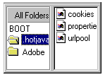
Swing General Containers
JPanel - group components
JScrollPane - add scroll bars to a component
JSplitPane - display two separate panes
Notes:
Chapter 10 - <number>

Slide 32
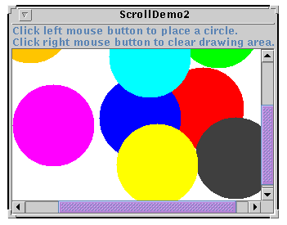
Swing JScrollPane
JScrollPane - adds scroll bars to component
  textArea = new JTextArea(5, 30);
  JScrollPane scrollPane = new JScrollPane(textArea);
  contentPane.add(scrollPane, BorderLayout.CENTER);
Notes:
Chapter 10 - <number>

Slide 33
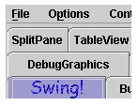

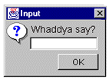
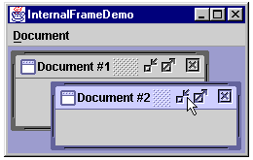
Swing Special Purpose Containers
JTabbedPane - display contents of current tab
JToolBar - groups buttons with icons
JOptionPane - display dialog box
JInternalFrame - inside frames
Notes:
Chapter 10 - <number>

Slide 34

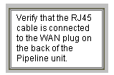
Swing Text Components
JLabel - not editable text and/or image
    JLabel firstNameLabel = new JLabel(“Label 5”,dukeIcon);
JTextField - one line text entry and/or display
    JTextField nameField = new JTextField(40);
    String name = nameField.getText();
JPasswordField - hides typed characters
    JPasswordField passField = new JPasswordField(8);
    String password = passField.getPassword();
JTextArea - multi-line text entry and/or display
    JTextArea commentArea = new JTextArea(2,30);
    String comment = commentArea.getText();
    commentArea.setText(comment);
Notes:
Chapter 10 - <number>

Slide 35
Fortune Teller Exercise
Add a JLabel and JTextField to the fortunePanel
  In initialize()
  Use the label to display
    Your fortune is:
  Use the text field to display a random fortune
    Get from the getRandomFortune() method
Finish the code for handling the button push
  Set the text for the text field to a random fortune from the array

Slide 36

Swing Button Components
JButton - push for action
    JButton rightButton = new JButton(“Right”,arrowIcon);
JRadioButton - pick one of several in a group
    JRadioButton oneButton = new JRadioButton(“One”);
    JRadioButton twoButton = new JRadioButton(“Two”);
    ButtonGroup buttonGroup = new ButtonGroup();
    buttonGroup.add(oneButton);
    buttonGroup.add(twoButton);
    JRadioButton selButton = (JRadioButton) buttonGroup.getSelection();
JCheckBox - make an item true or false
    JCheckBox fruitsBox = new JCheckBox(“Fruits”);
    boolean showFruits = fruitsBox.isSelected();
Notes:
Chapter 10 - <number>

Slide 37
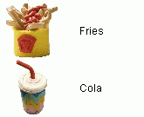


Swing List Components
JList - displays a list of items and user may select one or more
    Color colors[] = {“Black”, “Blue”, “Green};
    JList colorList = new JList(colors);
    colorList.setVisibleRowCount(2);
    String color = colorList.getSelectedValue();
JComboBox - drop down list with selected displayed, can set up for text entry too
    JComboBox colorBox = new JComboBox(colorList);
    String currColor = colorBox.getSelectedItem();
Notes:
Chapter 10 - <number>

Slide 38
Swing Slider and Progress Bar
JSlider - show a value in a range or pick a value from a continuous range
    s = new JSlider(100, 1000, 400);
    s.setPaintTicks(true);
    s.setMajorTickSpacing(100);
    s.getValue(); // get the current value from a slider
JProgressBar - used to show how long a user needs to wait yet.
  progressBar = new JProgressBar(JProgressBar.HORIZONTAL, 0, text.length());
Notes:
Chapter 10 - <number>

Slide 39
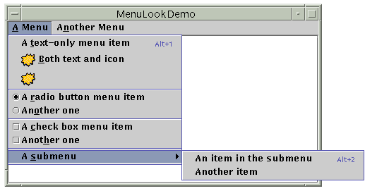
Swing JMenu
A JFrame can have a Menu bar
  JMenuBar menuBar = new JMenuBar(); // create a menu bar
  setJMenuBar(menuBar); // set the menu bar in the JFrame
  JMenu menu = new JMenu("A Menu"); // create a menu
  menuBar.add(menu); // add it to the menu bar
  menuItem = new JMenuItem("A text-only menu item", KeyEvent.VK_T);
  menu.add(menuItem);
Notes:
Chapter 10 - <number>
There are also pop-up menus.

Slide 40

Menu Exercise
Add to PersonFrame\PersonFrame a JMenuBar that has an Action menu with two menu items: Reset and Quit.
When the Reset menu item is selected call the resetAllItems() method.
When the Quit menu item is selected quit the application.
Notes:
Chapter 10 - <number>
In the constructor create and set up the JMenuBar, actionMenu, and menu items.
Add anonymous inner classes for the Reset and Quit menu items and take the appropriate actions.
To reset text fields use
textField.setText(“”);
To reset the combo box use
comboBox.setSelectedIndex(0);
To reset the list use
clearSelection();
To reset the checkboxes and radio buttons use
box.setSelected(false);

Slide 41
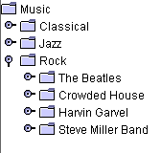
Swing JTree
JTree - Selection tree with expandable nodes
    DefaultMutableTreeNode musicNode = new DefaultMutableTreeNode("Music");
    DefaultMutableTreeNode rockNode = new DefaultMutableTreeNode(”Rock");
    musicNode.add(rockNode);
    rockNode.add(new DefaultMutableTreeNode(”The Beatles"));
    JTree tree = new JTree(musicNode);
    add(tree);
Notes:
Chapter 10 - <number>

Slide 42

Swing JTable
JTable - displays a table of same height data
  Object[][] data =
  {{“Wilma”,”Flintstone”,new Integer(1), new Boolean(true)},
  {”Betty", ”Rubble",new Integer(2), new Boolean(true)},
  {“Gazo”,”Gizmo”,new Integer(5),new Boolean(false)},
  {“Fred”, “Flintstone”,new Integer(1), new Boolean(true)}};
  String[] columnNames = {"First Name", "Last Name”,” # Children”,”US Citizen”};
  final JTable table = new JTable(data, columnNames);
table.setPreferredScrollableViewportSize(new Dimension(500, 70));
JScrollPane scrollPane = new JScrollPane(table);
setContentPane(scrollPane);
Notes:
Chapter 10 - <number>
It is actually better to create a JTable with a TableModel.
Notice that tables contain objects so you must use the wrapper classes Integer, Float, Double, Boolean, etc instead of primitives.
See http://java.sun.com/docs/books/tutorial/uiswing/components/table.html for tutorials on making tables.

Slide 43
TableModel
The JTable constructor that takes the data and column names as arrays is easy but
  all cells are editable
  all data is displayed as a string
  all data must be in an array
Use a table model for more control over a JTable by subclassing AbstractTableModel. You must override the following methods:
  public int getRowCount();
  public int getColumnCount();
  public Object getValueAt(int row, int column);
Notes:
Chapter 10 - <number>

Slide 44
TableModel - Continued
You can also override:
  public String getColumnName(int col);
  public boolean isCellEditable(int row, int col);
  public void setValueAt(Object value, int row, int col);
  public Object getValueAt(int row, int col);
  public Class getColumnClass(int c);
Notes:
Chapter 10 - <number>

Slide 45

TableDemo Exercise
Modify TableDemo\TableDemo to use a TableModel that specifies the class types of the columns and makes all columns not editable.
Notes:
Chapter 10 - <number>
Add the following method to the SimpleTableModel class to return the Class of the object at the passed column
public Class getColumnClass(int c)
{}
Use the getClass() method of Object to get the Class object of an object and use this to get the class of an object in the table.
Class currClass = varName.getClass();
Add the following method to the SimpleTableModel class to make all the columns not editable.
public boolean isCellEditable(int row, int col)
{ return false; }

Slide 46
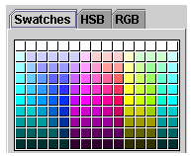
Color Chooser
JColorChooser - use to pick a color
  Use the static method showDialog and pass it the parent component, title, and current color
    Color newColor = JColorChooser.showDialog(
    parentComponent,title,selColor);
  Example
    Color newColor = JColorChooser.showDialog(
    this, “Pick a new background color”,this.getBackground());
Notes:
Chapter 10 - <number>
The JColorChooser class provides a static method showDialog which takes the parent component for the dialog, the title, and the currently selected color. It will return a color that the user selects.
For an example of using this see ColorChooser.java in c:\intro-prog-java\bookclasses.

Slide 47
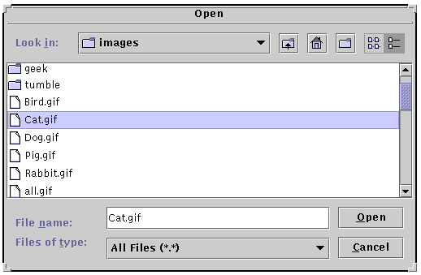
File Chooser
JFileChooser - use to pick a file
    // create the file chooser
    final JFileChooser fc = new JFileChooser();
    // display the chooser as a dialog and get the return value
    int returnVal = fc.showOpenDialog(frame);
    // if the return value shows that the user selected a file
    if (returnVal == JFileChooser.APPROVE_OPTION) {
    File file = fc.getSelectedFile();
    }
Notes:
Chapter 10 - <number>
For an example of using this see FileChooser.java in c:\intro-prog-java\bookclasses.

Slide 48
Images in Swing
Swing creates an ImageIcon from an Image, file name, or URL
    ImageIcon icon = new ImageIcon(currImage);
    ImageIcon icon = new ImageIcon(fileName);
    ImageIcon icon = new ImageIcon(currURL);
ImageIcons can be used in labels, menus, lists, tables, and buttons
    JLabel imageLabel = new JLabel(icon);
    JButton nextButton = new JButton(“Next”,nextIcon);
    JButton prevButton = new JButton(“Prev”);
    prevButton.setIcon(prevIcon);
Notes:
Chapter 10 - <number>
The default path for searching for a file is the current working directory. You may need to specify the full path name or pass in the path name.

Slide 49
Borders
Any object that is a subclass of JComponent can have a border
The BorderFactory creates borders
  Border myBorder = BorderFactory.createBevelBorder(BevelBorder.RAISED);
  Border spaceBorder = BorderFactory.createEmptyBorder(3,3,3,3);
Use setBorder to set the components border
  setBorder(myBorder);
Notes:
Chapter 10 - <number>
The BevelBorder.RAISED constant requires the import of the javax.swing.border package
import javax.swing.border.*;

Slide 50
Types of Borders
BevelBorder - raised or lowered
CompoundBorder - consists of several borders
EmptyBorder - space around component
EtchedBorder - etched with highlight and shadow colors
LineBorder - box around component
MatteBorder - a color or image border
SoftBevelBorder - beveled border with softened corners
TitledBorder - component is boxed with a title
Notes:
Chapter 10 - <number>

Slide 51
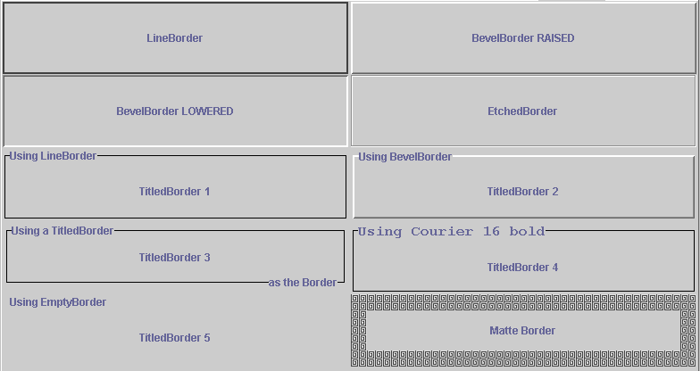
Border Examples
Notes:
Chapter 10 - <number>

Slide 52

Tool Tips
A tool tip is a popup text box that is displayed when the user holds a cursor over a component.
Any object that is a subclass of JComponent can have a tool tip
Set a tool tip using
  componentName.setToolTipText(“enter first name here”);
Notes:
Chapter 10 - <number>

Slide 53
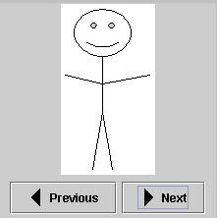
StepImageFrame Exercise
Add an icon created from the file left.gif to the previous button
Add an icon created from the file right.gif to the next button.
If you have time add tool tips to the buttons.
If you have time add a beveled border to the panel.
Notes:
Chapter 10 - <number>
Create an ImageIcon using the file name of the image file
ImageIcon nextIcon = new ImageIcon(“right.gif”);
A JButton can have both text and an ImageIcon.
nextButton = new JButton(“Next”,nextIcon);
To set the tool tip text use
setToolTipText(“the text to display”);
To create and set a beveled border
import javax.swing.border.*;
setBorder(BorderFactory.createBevelBorder(BevelBorder.LOWERED));

Slide 54
Summary
Use Swing components instead of AWT components whenever possible
Use the SwingSet for examples of working with Swing components
Use the Sun tutorial for examples
  http://java.sun.com/docs/books/tutorial/uiswing/index.html
In 1.1+ style event handling
  objects register themselves as interested in events
  when an event happens all objects that are registered as listening for that event are notified
Use anonymous inner classes to handle events
Notes:
Chapter 10 - <number>

